Slide 1
Desktop Management System
By prarthi joshi

Slide 2
Brief introduction
A desktop Management system is a system where all the process that are being executed at desktop can be managed. Here a small part of implementation has to be done which are as: -
Specific task Group Member-1
1) Implement File-handling concept to describe
a) Total number of files in a drive.
b) Total number of image files
c) Total number of word files
d) Total number of text files(.txt)
e) Total number of executable files.

Slide 3
working
1. Start.
2. Take directory pointer, variable for each file type i, j, k, l, m, L_file, cpp, file_size for count for total file, image, word, text, executable file, max. length of file, count for .cpp extention file and file size. Take sting variable str,str1,str2, name etc. for string storing.
3. Take pointer ep for dirent structure.
4. Open Desktop directory and read each file in Desktop directory.
5. Create three case for 3 task.

Slide 4
Header file
#include <iostream>
#include <dirent.h>
#include <stdlib.h>
#include <conio.h>
#include <iomanip>
#include <fstream>

Slide 5
Uses of header file
<iostream> - standard input output header file
<stdlib.h>- general purpose standard library of C programming language which includes functions involving memory allocation, process control, conversions and others.
<conio.h> - conio.h is a C header file used mostly by MS-DOS compilers to provide console input/output.
<iomanip> - The header <iomanip> is part of the Input/output library of the C++ Standard Library. It defines the manipulator functions.
<fstream> - To perform file processing in C++, header files <iostream> and <fstream> must be included in your C++ source file.

Slide 6
Functions used
void process(int a) – It used switch cases to open directory and get file size, sorting files, counting files etc.
void display(int a) – it displays the output of all switch cases and also use manipulators to format the output
I have used do while loops for 3 task
Show all files in directory
Set individual files in specific folder
Largest file among all

Slide 7
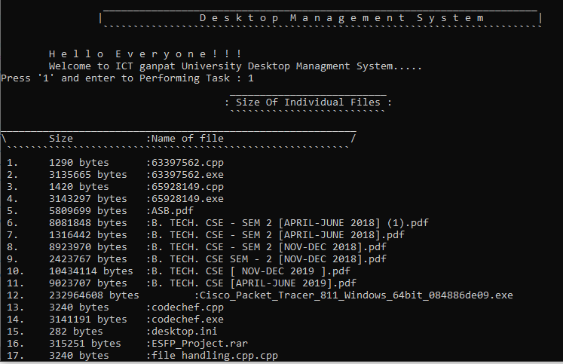
output

Slide 8

